Slide 1
Building UAV Control Pipelines using MAVProxy and PyMAVLink

Slide 2
Agenda
Introduction
What is MAVLink, MAVProxy, and PyMAVLink
How they fit into the ArduPilot ecosystem
Part 1 — MAVProxy
Concepts
MAVProxy overview and role in GCS stack
Installation and setup
Connecting to SITL
Modules, commands, and outputs
Hands-on
Connect SITL to MAVProxy
Monitor parameters, heartbeats, and mode changes
Control vehicle via console

Slide 3
Part 2 — PyMAVLink
Concepts
PYMAVLink overview & architecture
Connecting to MAVLink endpoints
Common message types & commands
Hands-on
Write Python scripts to:
  Arm & takeoff
  Change flight modes
  Vehicle connections
  Arm and Disarm
  Get vehicle data
  Send vehicle data

Slide 4
MAVPROXY

Slide 5
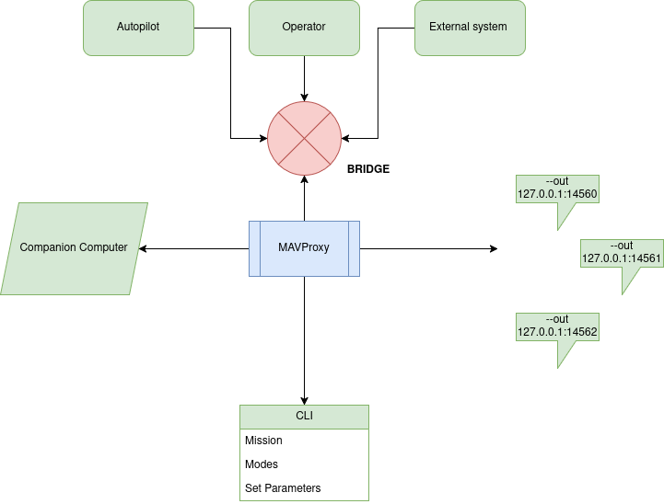
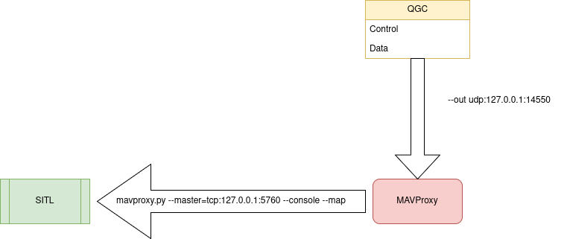
Introduction to MAVProxy — The Command-Line Ground Control Station
🧠 What is MAVProxy?
A lightweight, command-line Ground Control Station (GCS) for MAVLink-enabled vehicles.
Acts as a router and monitor for MAVLink messages between autopilot, SITL, and other GCS tools (like QGroundControl).
Written in Python

Slide 6
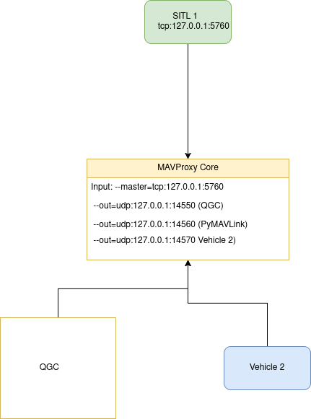

MAVProxy as a Communication Hub

Slide 7
Connect SITL Instance + MAVProxy + QGC
step 1
cd && cd ardu-sim/
step 2
./arducopter -S --model + --speedup 1 --defaults parameters/copter.parm -I0
step 3
mavproxy.py --master tcp:127.0.0.1:5760
step 4 Connect to QGC
mavproxy.py --master tcp:127.0.0.1:5760 --out udp:127.0.0.1:14550

Slide 8
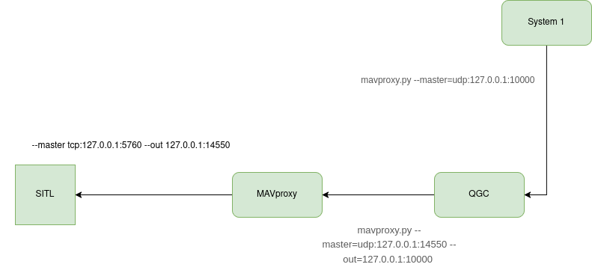
Telemetry Forwarding

Slide 9
Try Telemetry Forwarding
Step 1
cd ardu-sim
./ardu-sim.sh
screen -ls
Step 2 - New terminal
mavproxy.py --master=udp:127.0.0.1:14550 --out=127.0.0.1:10000
Step 3 - New terminal ( Forward Instance )
mavproxy.py --master=udp:127.0.0.1:10000

Slide 10
Arm Disarm Vehicle using MAVProxy
1. Connect to the vehicle using `mavproxy.py --master=127.0.0.1:14550 --console --map`.
2. To arm the vehicle type `arm throttle` in command line.
3. To disarm the vehicle type `disarm` in command line.
4. If you arm the vehicle and do nothing it automatically disarms after `DISARM_DELAY` seconds.
5. To show disarm delay parameter `param show DISARM_DELAY`.
6. To set disarm delay parameter to 10 seconds `param set DISARM_DELAY 10`.

Slide 11
Change Flight Mode and Takeoff
1. Connect to the vehicle using `mavproxy.py --master=127.0.0.1:14550 --console --map`.
2. To change the flight mode `mode` in command line.
3. Example `mode GUIDED`.
4. Let's take off the vehicle to the 10 meters:
1. `mode GUIDED`
2. `arm throttle`
3. `takeoff 10`
5. Let's get back our vehicle to the ground.
1. `mode RTL` or `mode LAND`
6. Let's fly to a location in GUIDED mode.
1. `guided -35.36217477 149.16507393 10`

Slide 12
System command
Connect to the vehicle using: mavproxy.py --master=127.0.0.1:14550 and press tab.
reboot command is used to soft restart flight controller.
time is used to show time on flight controller and computer.
shell is used to run a shell command.
status command shows the latest packets.

Slide 13
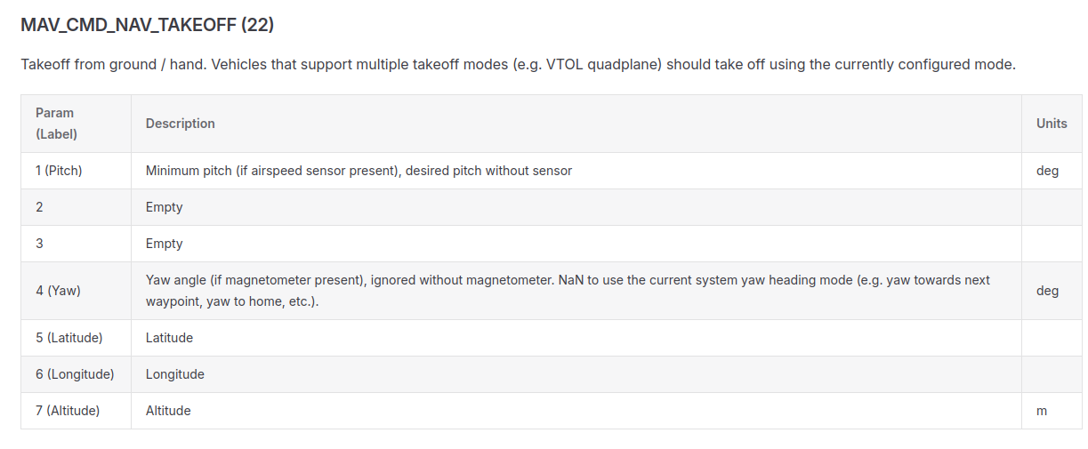
Long Command
Long command enables user to send MAV_CMD_* commands to vehicle.
It is used to send COMMAND_LONG messages to the vehicle to give commands during flight.
All the parameters are in float.
It uses command service of the MAVLink.
Usage is: long COMMAND_NAME PARAM1 PARAM2 PARAM3 PARAM4 PARAM5 PARAM6 PARAM7
Lets takeoff in guided mode using MAV_CMD_NAV_TAKEOFF:
arm throttle
  long MAV_CMD_NAV_TAKEOFF 0 0 0 0 0 0 10
  This command needs takeoff altitude in meters as its 7th parameter.

Slide 14
PYMAVLink

Slide 15
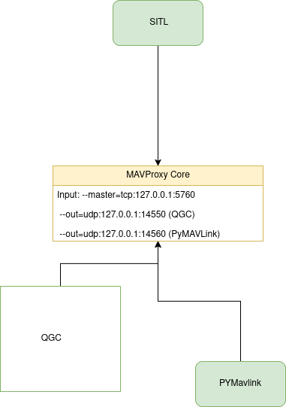
Connection with PYMAVLink

Slide 16
Connect to the Vehicle
import pymavlink.mavutil
# connect to vehicle
vehicle = pymavlink.mavutil.mavlink_connection(device="udpin:127.0.0.1:14570")
# wait for a heartbeat
vehicle.wait_heartbeat(timeout=5)
# debugging messages
print("Connected to the vehicle")
print("Target system:", vehicle.target_system, "Target component:", vehicle.target_component)

Slide 17
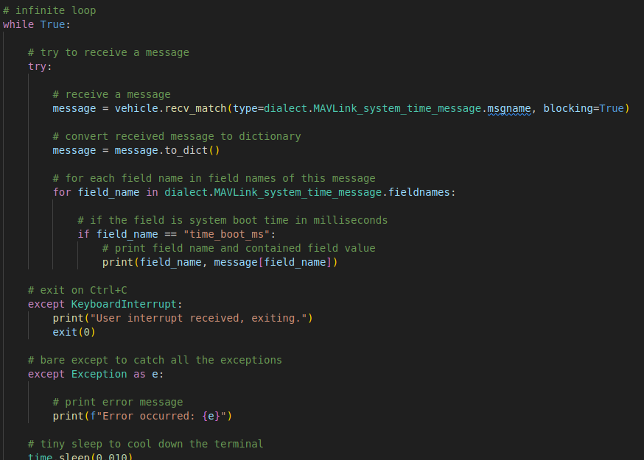
Receiving Message from Vehicle

Slide 18
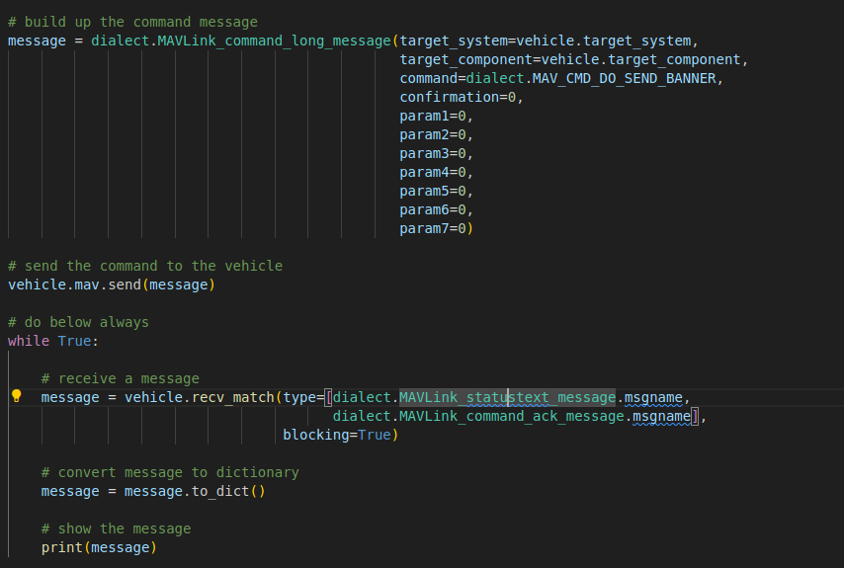
Sending Message to the Vehicle

Slide 19
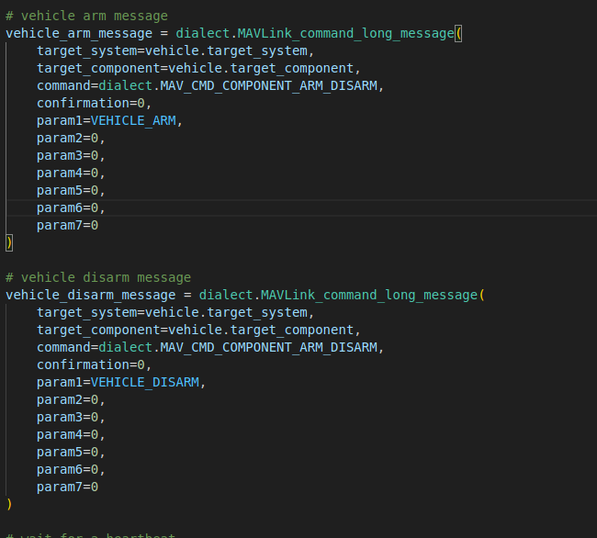
Arming and Disarming of Vehicle

Slide 20
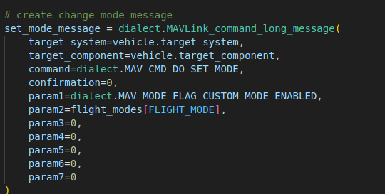
Flight Modes

Slide 21
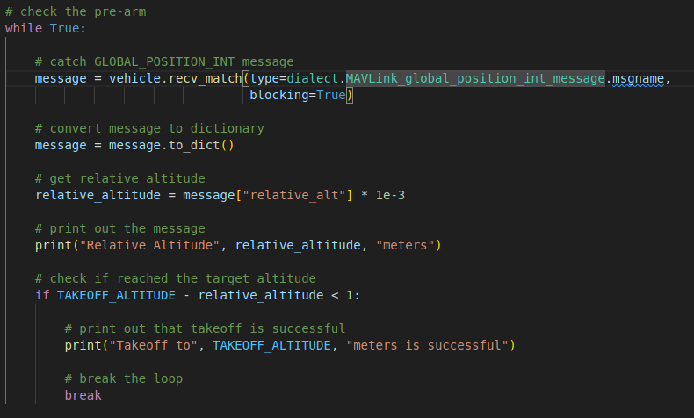
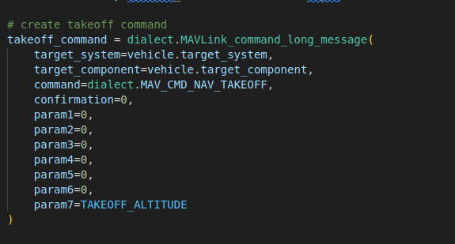
Take OFF

Slide 22
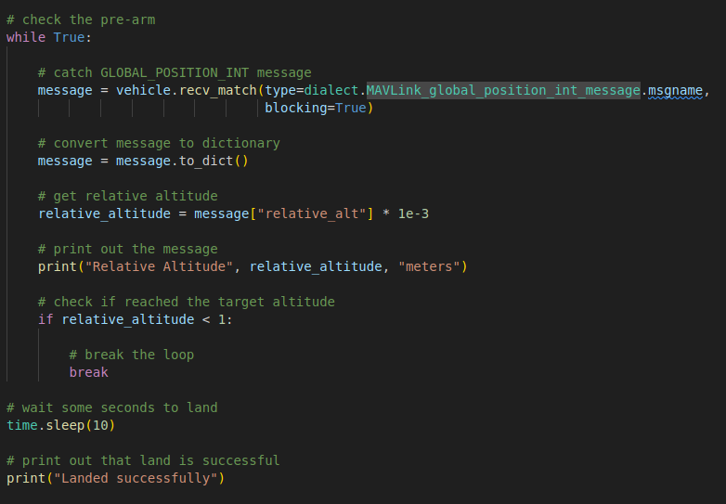
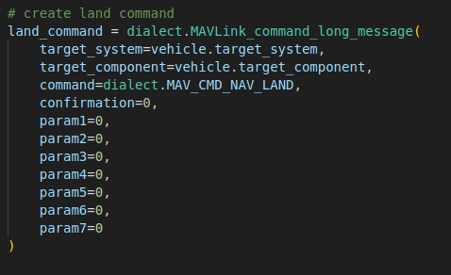
Land Command

Slide 23
Case Study : How MAVLink 2 powers real-time coordination in next-generation combat UAVs
Collaborative Combat UAV

Slide 24
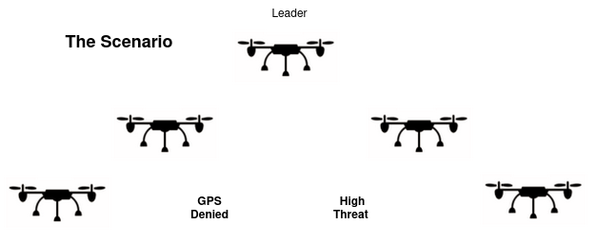
Mission Scenario
Each UAV is both a sensor and a teammate — sharing data, reacting collectively.

Slide 25
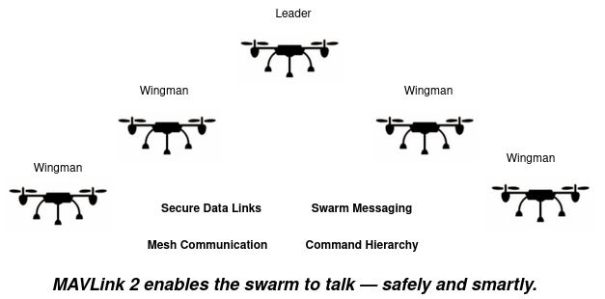
MAVLink 2: The Digital Backbone

Slide 26
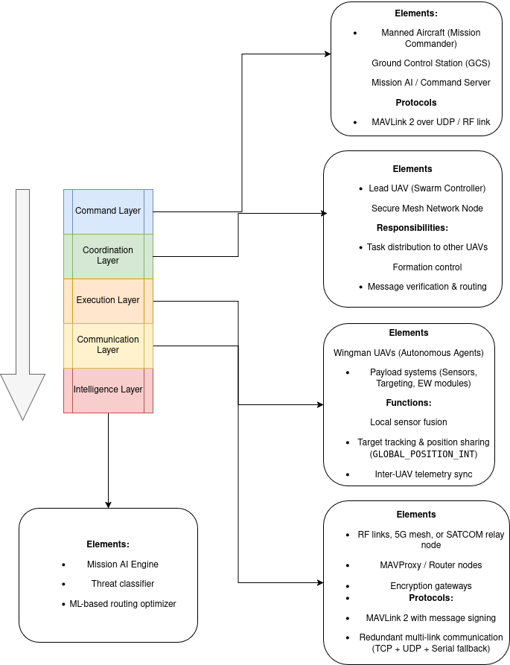
Solution Architecture: Collaborative Combat UAVs (CCA)

Slide 27
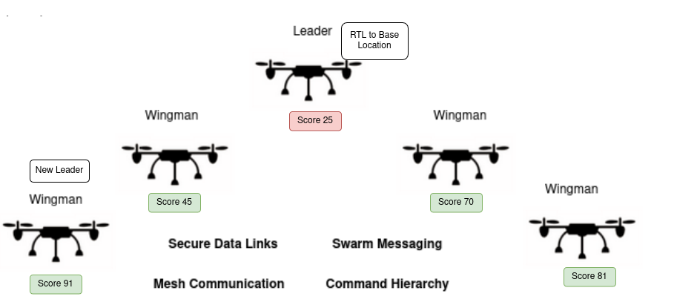
Rotation Leader Policy

